Slide 1
Load-Optimal Local Fast Rerouting for Relisient Networks
Authors: Mózsi Krisztián, Nagy András

Slide 2
About the article
Need for faster failover protocol when mutiplie edge fall out.
Not using pacake tagging. (Additional information for packages to rerouing)
Build a static failover matrix in order that the alternative route should not be recoputied in runtime.

Slide 3
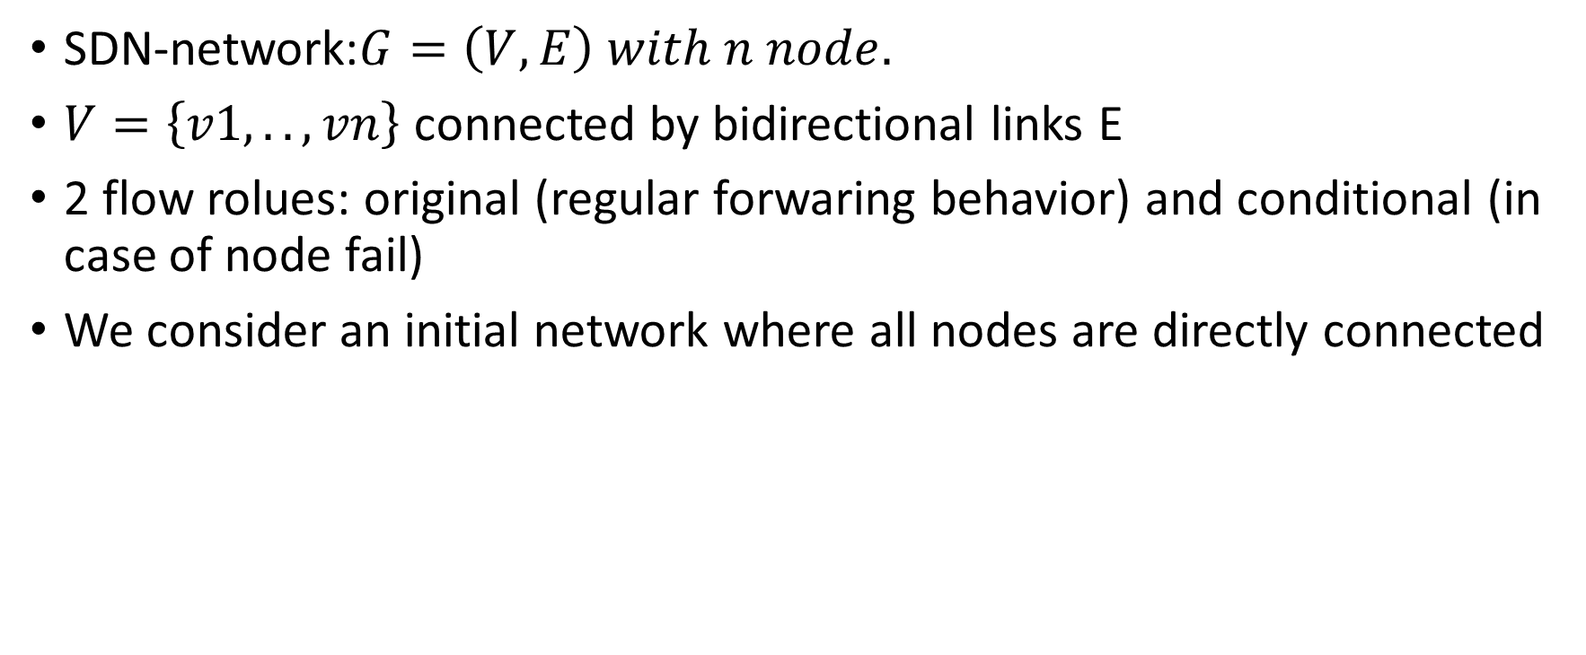
Problem statement model
SDN-network:$G=\left(V, E\right) with n node.$
$V=\left\{v1, .. , vn\right\}$ connected by bidirectional links E
2 flow rolues: original (regular forwaring behavior) and conditional (in case of node fail)
We consider an initial network where all nodes are directly connected

Slide 4

Main definitions
Load overhead: $θ\left(e\right)$ is a number of corrsing flow considering an e edge due the reouring. $θ=\max{θ\left(e\right)}$
Optimal attack: $F ⊆E$ that generates the worst overhead load $θ$. $F\left(θ\right)$ is the minimal required number of failures leading to an overhead load $θ$

Slide 5
Failover matrix model
Using All-to One routing
n flow, n node
S failover schame repesented as M = [mi,j]
ith flow means: we want to foward a message from si to di. If there is not direct link between them we using the ith flow to search alternative routes for the di.

Slide 6

1
6
2
$$\left[1, 2, 3, 4, 5, 6\right]$$
5
3
4

Slide 7
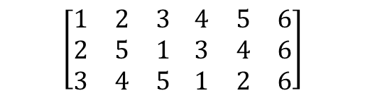
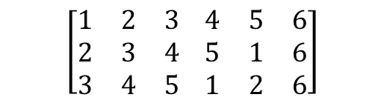
Performance
Let F = {(1,6), (2,6), (3,6)}
$$\left[\begin{matrix}1 & 2 & 3 \\ 2 & 3 & 4 \\ 3 & 4 & 5\end{matrix} \begin{matrix}4 & 5 & 6 \\ 5 & 1 & 6 \\ 1 & 2 & 6\end{matrix}\right]$$
$$\left[\begin{matrix}1 & 2 & 3 \\ 2 & 5 & 1 \\ 3 & 4 & 5\end{matrix} \begin{matrix}4 & 5 & 6 \\ 3 & 4 & 6 \\ 1 & 2 & 6\end{matrix}\right]$$
vs
The resulting overhead load is 3 on (4,6) in the left matrix while it is 2 on the left.
The worst perfromace comes from the simialarity of each node scheme.

Slide 8
Latin square shcmaes
Each node appears exactliy onece in each column and each row.
Not all latin squares are good failover matrices. (mij = (i+j-1) mod (n-1))
TODO pl.
If f first llinks fail, the f first nodes will all route rougth throw v(v f+1, d)
The intersection of prefixes of rows plays a central role.

Slide 9
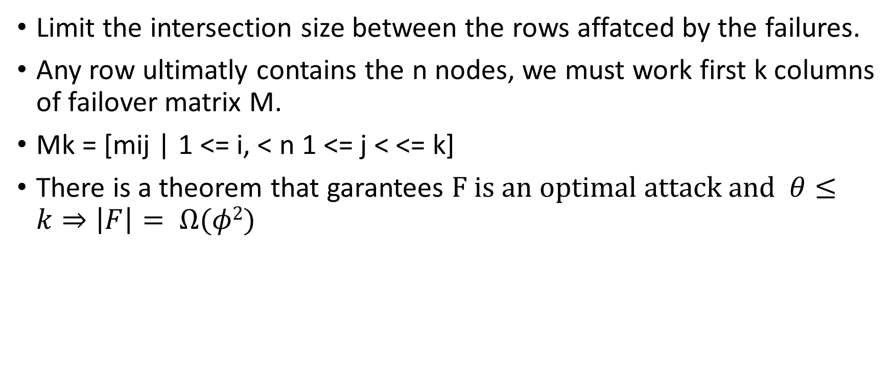
M^{k} matrix
Limit the intersection size between the rows affatced by the failures.
Any row ultimatly contains the n nodes, we must work first k columns of failover matrix M.
Mk = [mij | 1 <= i, < n 1 <= j < <= k]
There is a theorem that garantees $F is an optimal attack and θ≤k⇒\left|F\right|= Ω(φ2)$

Slide 10
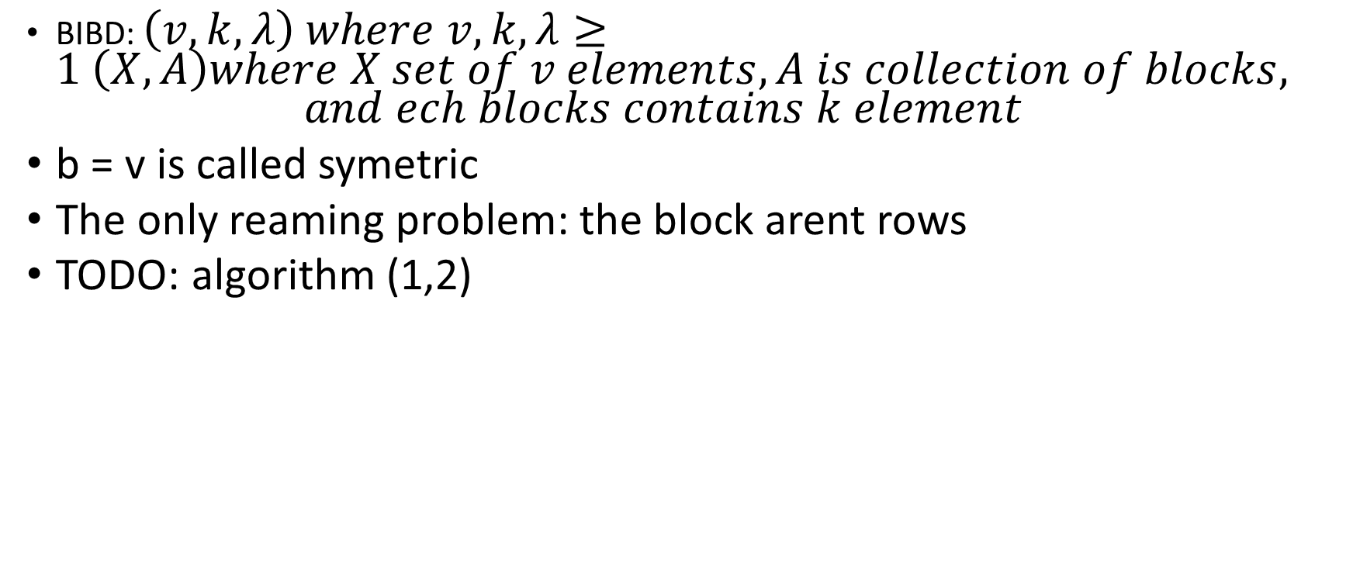
How to create submatrices of low intersection
BIBD: $\left(v, k, λ\right) where v,k, λ≥1 \left(X,A\right)where X set of v elements, A is collection of blocks,$ $and ech blocks contains k element$
b = v is called symetric
The only reaming problem: the block arent rows
TODO: algorithm (1,2)

Slide 11

Prmutation routing
Generalize All-to One routing to permutation routing problem.
$π :V →V each node v communicates with its image π(v)$

